Slide 1




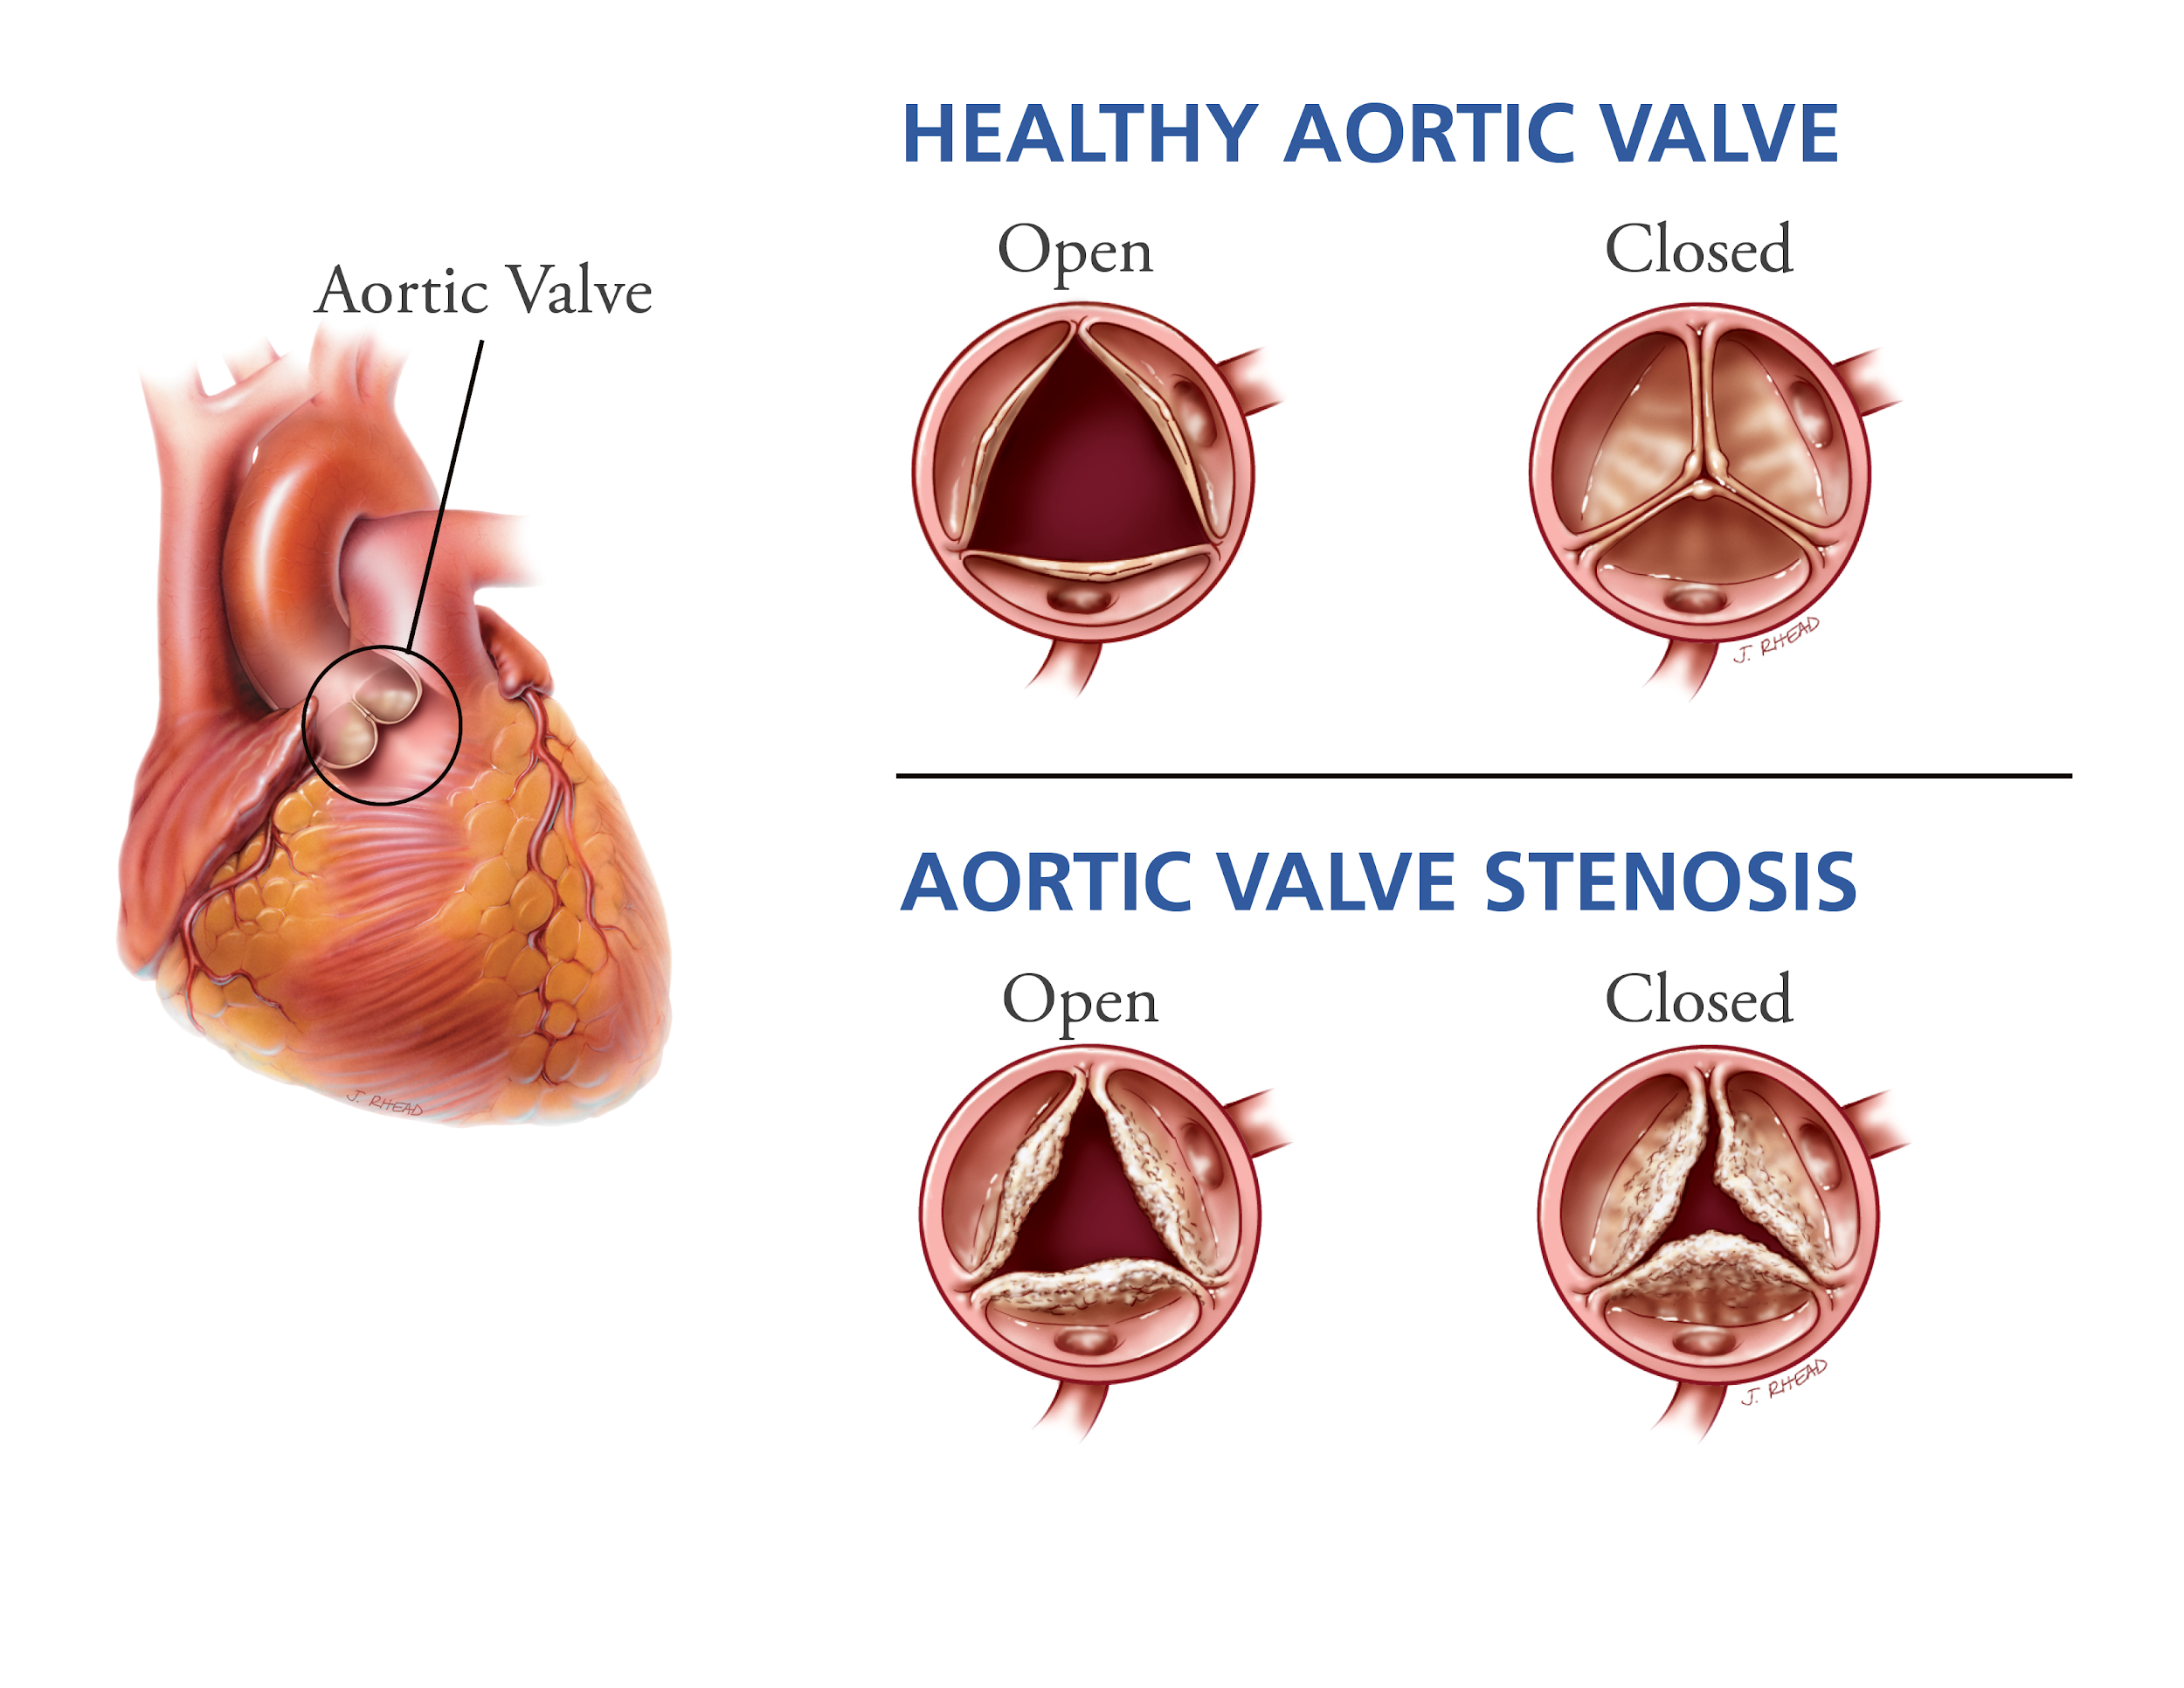
Annual Graduate Research Day
10th
Tricuspid vs. Mitral Performance of Cylindrical Porcine Small Intestinal Submucosa Valves
Introduction
AUTHORS:
Chia-Pei Denise Hsu¹
Asad Mirza¹
Robert Matheny²
Sharan Ramaswamy¹
FACULTY ADVISOR:
Sharan Ramaswamy
¹Florida International University
Miami, FL 33174
²Cormatrix Cardiovascular Inc.
Roswell, GA 30076
Methods
Results
Conclusion
Valve Diseases:
Congenital valve defect
Calcification
Degeneration
Healthy Valve
Stenosis
Regurgitation
Reduced cardiac output
Valves:
Maintain proper direction of blood flow
Valve Stenosis
Notes:
Heart valves help us maintain proper direction of blood flow. However, valves are subject to diseases such as congenital valve defects, valve calcification, and valve degeneration, resulting in stenosis, regurgitation, and reduced cardiac output.

Slide 2
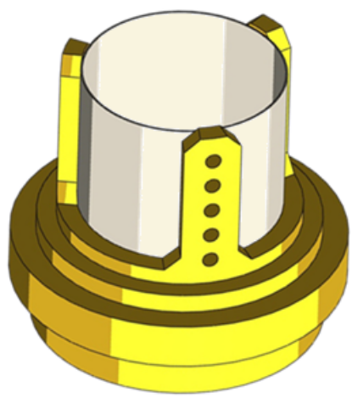
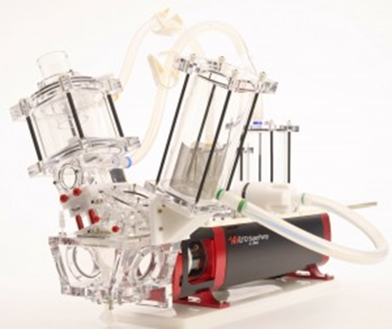


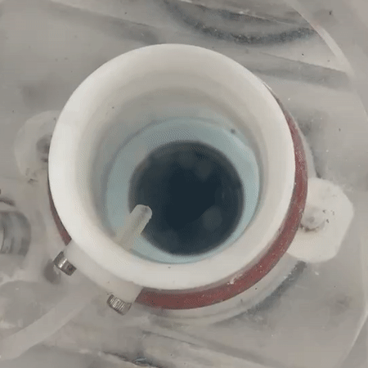
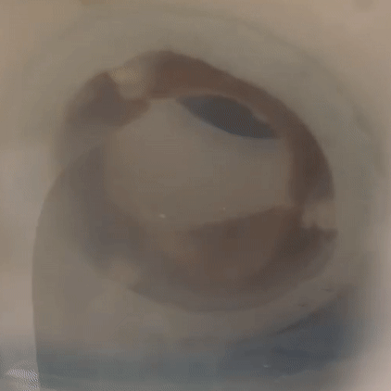
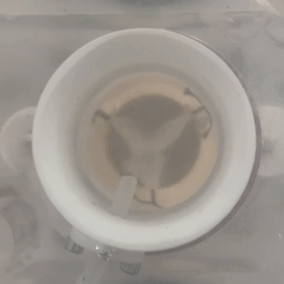

Annual Graduate Research Day Methods
10th
Methods
TRICUSPID
MITRAL
Waveform: 35%-systolic-65%-diastolic
MPP: 15 mmHg
MAP: 100 mmHg
SV: 50 mL
SV: 71 mL
Results
HR: 70 bpm
Conclusion
Porcine Small Intestinal Submucosa (PSIS)
26-mm hollow cylinder
Acellular extracellular matrix
Stentless and seamless
In FDA trials
Vivitro Pulse Duplicator
Assessment Criteria
Regurgitation Factor
(%)
Transvalvular Pressure (ΔP)
Volumetric Flow
(Q_{RMS})
Effective Orifice Area (EOA)
Mechanical Valve
(control)
Bioprosthetic Valve
(control)
PSIS Valve
(N=4)
Notes:
Due to limited treatment options available, research is developing heart valves with regenerative capacities. Porcine Small Intestinal Submucosa, or PSIS, is an available option that is clinically used for cardiovascular applications. Cormatrix Cardiovascular has developed cylindrical, stentless, and seamless PSIS valves in various sizes that are currently undergoing FDA trials, and they can be used as an alternative valve replacement option.
We tested the hydrodynamic performances of the cylindrical PSIS valves under both tricuspid and mitral conditions at N=4 for each condition. Assessment criteria include regurgitation percentage, transvalvular pressure, volumetric flow, and effective orifice area. The cylindrical PSIS valve functions were then compared to clinically available bi-leaflet mechanical valve and bioprosthetic valves of a similar diameter.

Slide 3
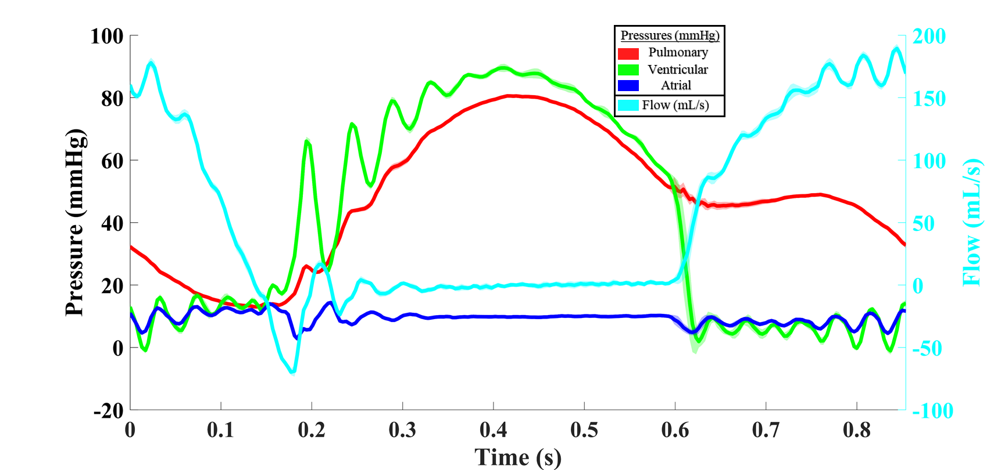
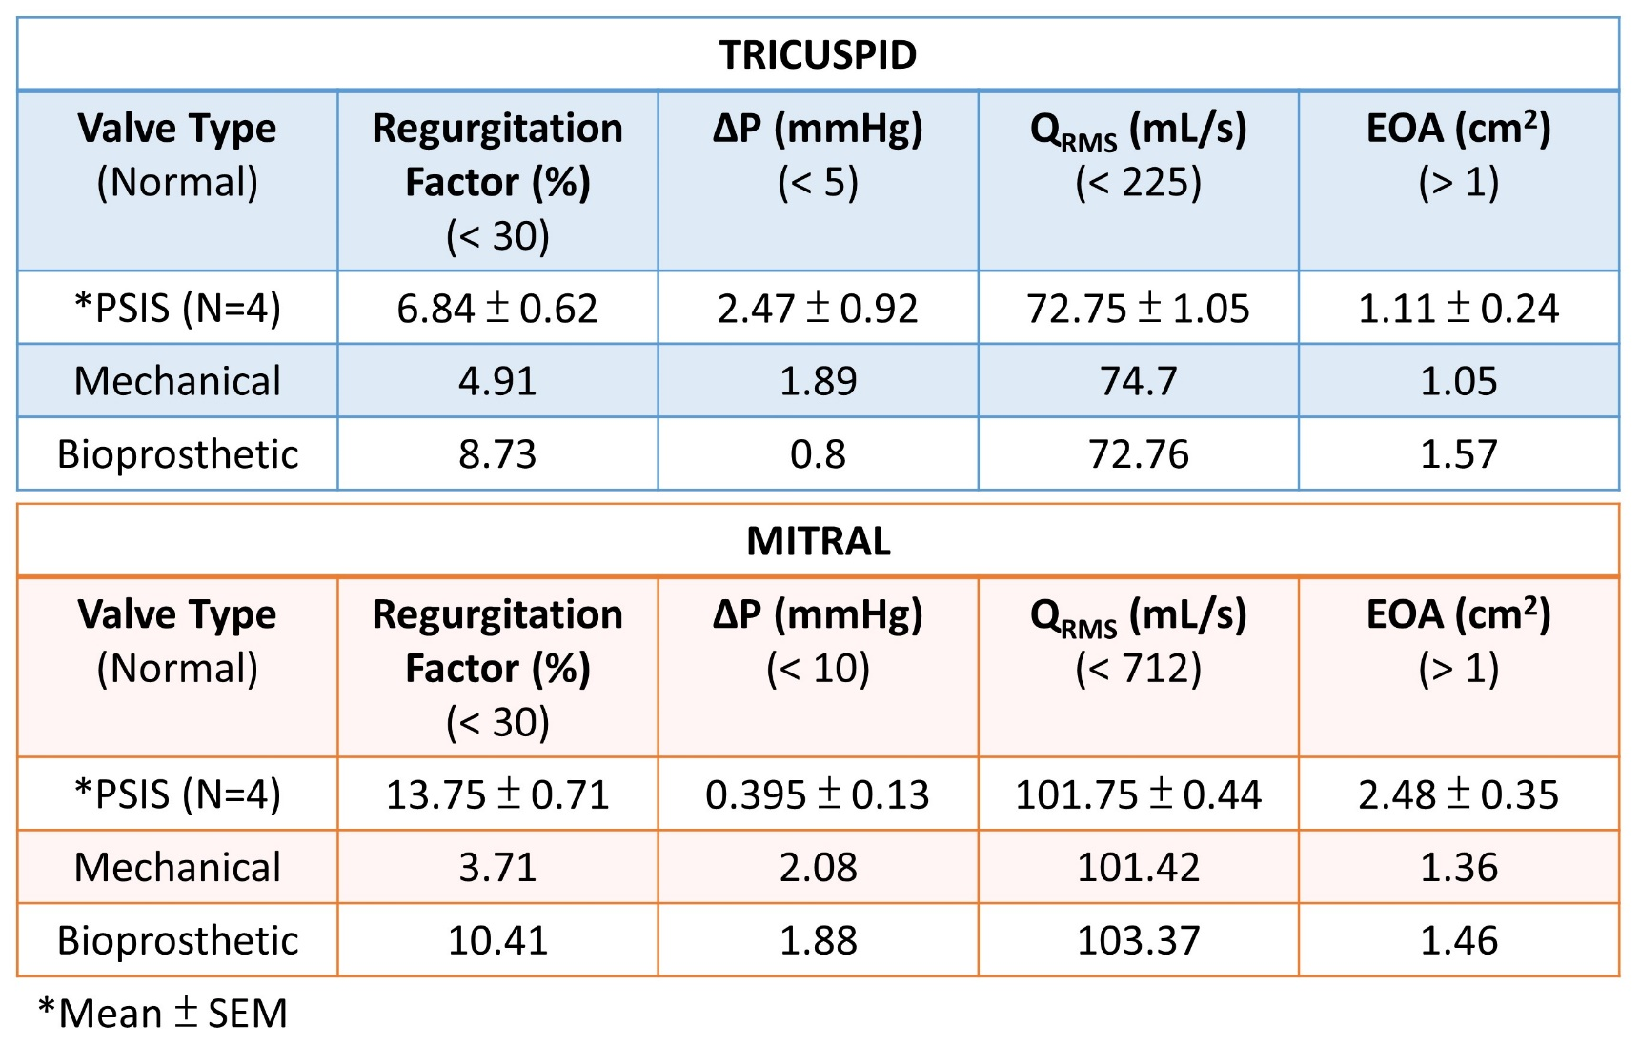
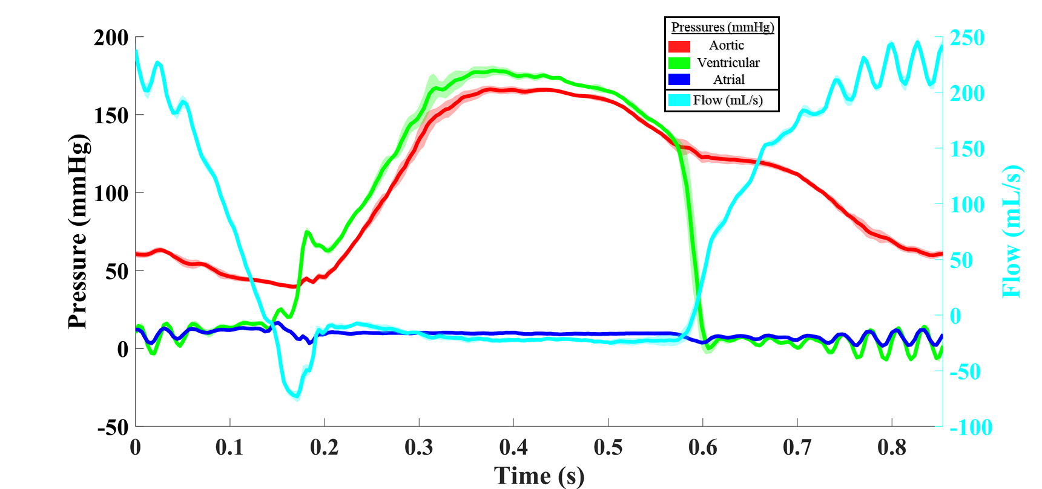
Annual Graduate Research Day Results
10th
Results
TRICUSPID
Conclusion
MITRAL
Notes:
Using the clinically available mechanical and bioprosthetic valves as controls for comparison, the PSIS valves show a relatively similar performance in both the tricuspid and mitral positions. However, there is an overall slightly higher leakage under the mitral conditions, and this may be mainly due to a higher pressure in the mitral compared to the tricuspid environment. Though, based on literature values that define normal and poor valve function, the PSIS valves are normal and not stenotic under tricuspid or mitral conditions.

Slide 4
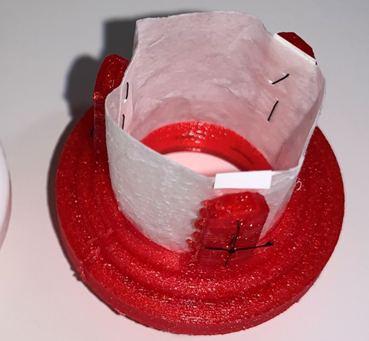
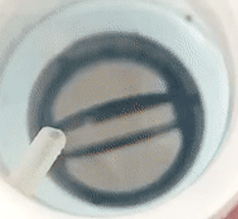
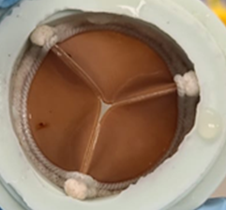
Annual Graduate Research Day
10th
Discussion/Conclusion
*√ better performance
Valve Type | Parameter | Tricuspid | Mitral | Overall Performance
Cylindrical PSIS | Regurgitation
 | ΔP
 | EOA
Mechanical | Regurgitation
 | ΔP
 | EOA
Bioprosthetic | Regurgitation
 | ΔP
 | EOA
√
√
Mitral ≥ Tricuspid
√
√
√
Mitral ≥ Tricuspid
√
√
√
Tricuspid > Mitral
√
Notes:
The goal of this study is to compare the mitral and tricuspid performances of PSIS valves based on the parameters. Our results show clinically acceptable hydrodynamic performance of cylindrical PSIS valves with comparable ΔP, Q_{RMS}, and EOA to clinically available mechanical and bioprosthetic valves. The cylindrical PSIS valve from CorMatrix shows a greater EOA and smaller pressure drop, but a larger regurgitation percentage in the mitral compared to tricuspid conditions. Hence transitioning the PSIS valve from its current tricuspid applications to the mitral side appears feasible, with a minor concern in regurgitation, though not clinically remarkable. The overall performance of PSIS and mechanical valves are similar in both mitral and tricuspid positions, while the bioprosthetic valve showed a better performance in the tricuspid position.

